Slide 1
Paralleling Generator
Systems for Emergency Standby
Applications
Basic Guideline
and Design Concepts

Slide 2
Company Background/About Me
BPS
  Family owned and operated since 1947
    9 locations throughout Ohio and Indiana
  Longest running Kohler distributor in the country
  Total power system package support
    Systems design and application
    Sales, rental and equipment delivery
    Service, planned maintenance, parts and repair
Josh Matthias
  Applications Engineer, Power Systems
  BSME – Purdue School of Engineering & Technology

Slide 3
Topics and learning objectives:
Introduction and concepts for generator paralleling
Paralleling generators for redundancy and capacity
On-board vs. Traditional Paralleling
Best practices and considerations

Slide 4
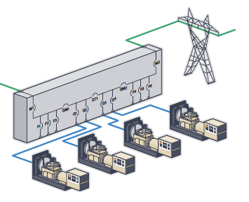
Paralleling Concepts
Paralleling
Synchronous operation of two or more generator sets connected together on a common bus
Typically done to meet large load demands, provide reliability or both
Also possible to parallel to utility
  Peak shaving
  Base loading

Slide 5
Benefits and Considerations
Redundancy
Increases reliability and availability
  N+1 generator scheme – 99.96% reliability
Removes a single point of failure
Operational Flexibility
Multiple gensets provide easier maintenance scheduling. One unit can be available to supply power to critical loads, while the others are offline for servicing.
Utilization of all available resources. Some facilities have multiple gensets without them being paralleled. Should one genset fail, it would not be possible to utilize the other gensets on campus.
Gensets can share load or run on intervals. This can improve fuel efficiency, prolong equipment life and reduce maintenance costs.
Expandability
Paralleling generator systems inherently provides protection against facility growth and/or an increase in electrical demand. With a paralleled generator system in place, additional generator capacity or redundancy can be added as needed.

Slide 6
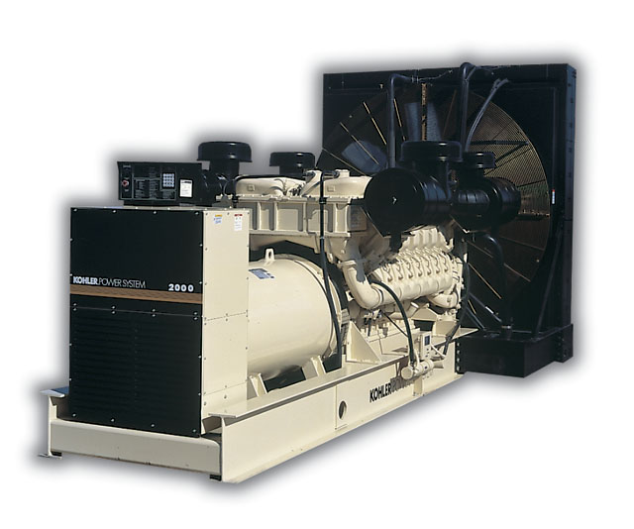
Redundancy vs. Capacity
Redundancy (N+1): Each generator can support entire load
1 MW Load
1 MW
1 MW
Capacity: Multiple units paralleled together to meet load demand
Note: Redundancy (N+1) can be also achieved by adding another 500kW unit.
1 MW Load
500 kW
500 kW

Slide 7
Redundancy Requirements
Consider whether redundancy is needed for the entire facility or critical loads only. It’s possible to have one large generator that can support the entire facility and utilize a smaller generator for only critical loads.
Cost savings
Spatial savings
Redundancy for critical systems
Still provides ease of serviceability
Facility Load
900 kW
1 MW
Critical Load
100kW
100 kW

Slide 8
Paralleling Operation
Typical Sequence of Operation (Emergency)
  Generator Start
  Load Management: Load Shed
  First-On Logic
  Synchronization
  Load Share (kW and kVAR)
  Load management: Add Load
  Generator Management
  Load Management: Failure/Overload Load Shed

Slide 9
Generator Start
In the event of a loss of utility service, one or more of the automatic transfer switches sends a start signal. All available generators start.

Slide 10
Load Management: Load Shed
If one generator cannot support the entire system load, lower priority loads are shed. This prevents the first-on generator from being overloaded.
ATS inhibit transfer
Feeder breakers open
Dry contact to signal downstream loads

Slide 11
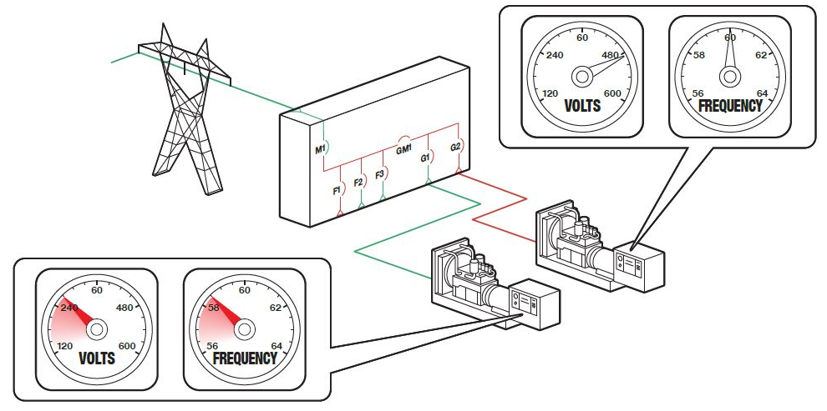
First-On Logic
First-on logic, also known as random access paralleling, allows the first generator to reach rated speed and voltage to close to the dead bus.
Prevents multiple generators from simultaneously closing to the bus
Used to get power to critical loads as soon as possible
Low priority loads may remain shed

Slide 12
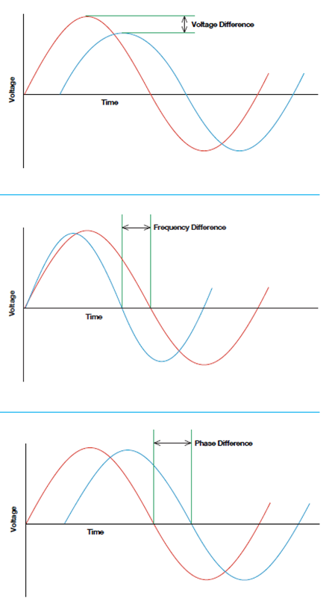
Synchronization
Voltage Match
Synchronizer adjusts the incoming generator’s voltage to match running bus
Frequency Match
Synchronizer adjusts the incoming generator’s speed to match frequency of running bus
Phase Match
Synchronizer adjusts the incoming generator’s speed to match phase of running bus

Slide 13
Load Share (kW and kVAR)
As additional generator power is available, the system’s load sharing controls actively control the kW and kVAR output of each generator. Each unit proportionally share the load so that percent load on each generator is the same.
  Ensures that one generator doesn’t work harder than the other
  Especially important on generators with varying capacity

Slide 14
Load Management: Load Add
Lower priority loads added by:
  Generator Bus Capacity
    Based on the kW capacity of the bus and a preset kW demand of the load
  Number of Generators Online
    Based on how many generators are connected to the bus
      Most effective in systems with same size generators

Slide 15
Generator Management
Optimizes the number of online generators based on load’s kW demand, starting and stopping as required
User sets all parameters associated with generator management and can enable or disable this mode of operation
Right side of screen graphically displays settings and current state of the system

Slide 16
Load Management: Failure/Overload Load Shed
Load shed event triggered by:
  Generator Failure
    Loads are shed based on the number of failed gensets
  kW Overload
    When the generators reach their overload setpoints, low-priority loads are sequentially shed until load falls below setpoint
  Underfrequency
    Often an indication the generators are fully loaded, when bus frequency reaches its underfrequency setpoint, preset loads are shed
Note: It is important to specify what loads can be shed and how they should be shed.

Slide 17
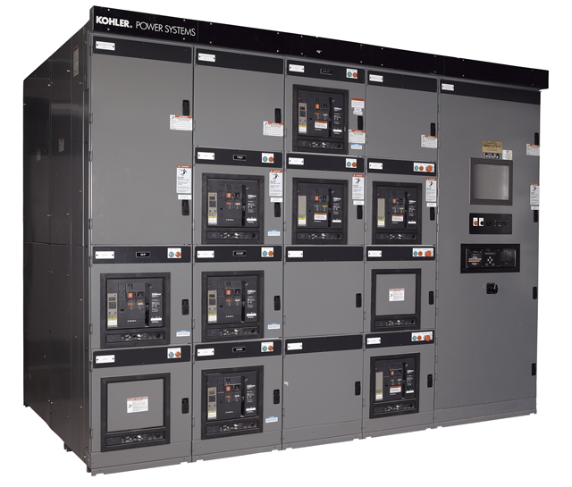
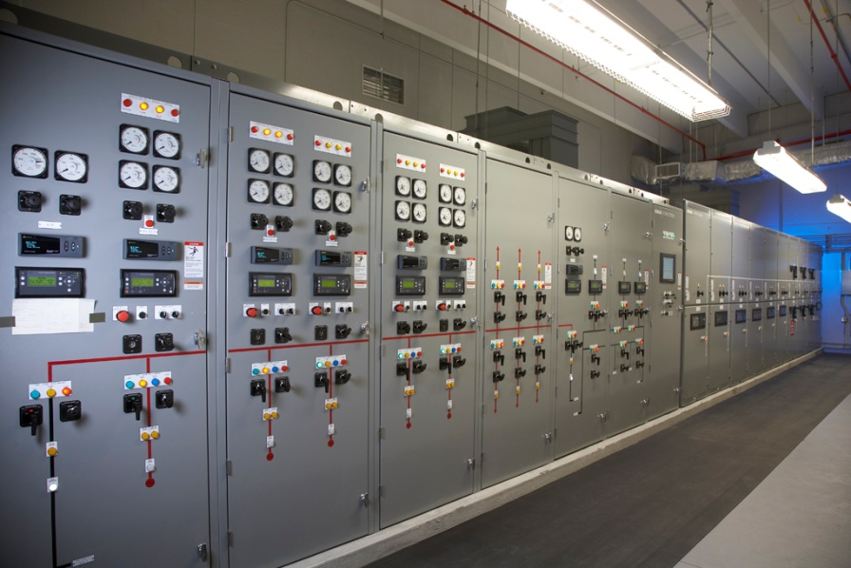
Traditional Paralleling
Paralleling Switchgear

Slide 18
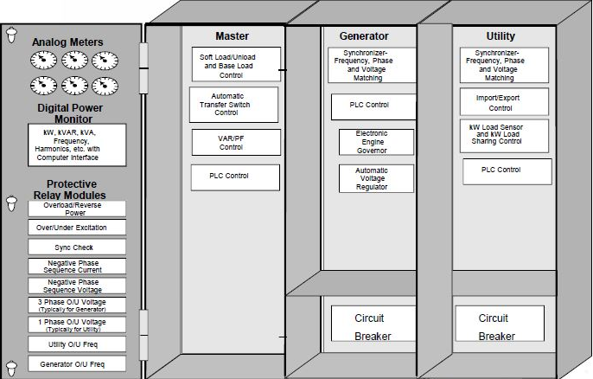
Traditional Paralleling Layout

Slide 19
Traditional Paralleling Concepts
BENEFITS
Customizable configurations and solutions
Complex sequence of operations
Everything located in one place, genset controls, breakers, utilities, protections
Able to parallel more than one utility source
DRAWBACKS
Large equipment footprint
  Control sections needed for each generator
Higher cost
Engineer to order product – longer lead times

Slide 20
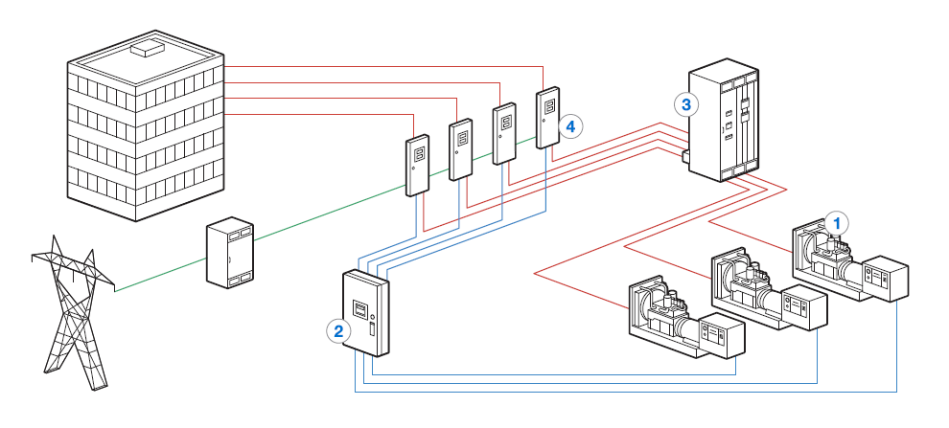
On-board Paralleling Concepts

Slide 21
On-board Paralleling Concepts
Paralleling takes place in the generator controllers
  First-on logic
  Automatic synchronizer
  kW load and kVAR load sharing
  Protective relays
  Generator set control and protection
Paralleling and distribution breakers can be mounted on the gensets or in switchboard/switchgear
  Electrically operated breakers used when mounted on genset
  Fixed mounted breakers and electrically or manual operated breakers can be used in switchboards
Master control panel handles generator and load management, monitoring and metering

Slide 22
On-board Paralleling Concepts
BENEFITS
Smaller equipment footprint
  No control sections for genset
Lower cost
Many paralleling applications simple enough on-board paralleling system can utilized
Simple design with fewer points of failure
Assembly to order product – shorter lead times
DRAWBACKS
Limited on customization
Not suitable for more complex system designs
May be difficult to integrate components

Slide 23
Paralleling Best Practices
Smallest genset should be large enough to power all life safety and critical loads
  Ensures that smallest genset to first close on the bus can take on these loads within 10 seconds
Diesel preferred fuel source
  Better transient performance
  Wider range of generator sizes
  All units available to take load within 10 seconds at whereas larger natural gas units require more time to get up to speed
  On site fuel supply, which may be required by code
Match new paralleled system generators with the same manufacturer
  Provides continuity and compatibility
  Enhances maintenance and simplifies operations

Slide 24

Josh Matthias
Applications Engineer
Buckeye Power Sales
O: (317) 273-6715
M: (317) 671-0544
jmatthias@BuckeyePowerSales.com
Questions?
Thank you!
Joe Downs II
Switchgear Specialist/Operations Manager
Buckeye Power Sales
O: (513) 785-5550
M: (937) 604-1561
jdowns@buckeyepowersales.com

